Slide 1
The Changing Landscape of Trade Negotiations
Alan V. Deardorff
University of Michigan
Lecture 2
Nankai University
February 29, 2016

Slide 2
How Trade Negotiations Have Changed
1945-1994
  Under GATT, 8 Rounds of Multilateral Trade Negotiations
    Reduced tariffs to about 1/10 what they were before
    On MFN (Most Favored Nation) basis
    Among all GATT Signatories
      15 countries in 1945
      128 countries in 1994

Slide 3
How Trade Negotiations Have Changed
1945-1994
  Culminated in the 1995 creation of the World Trade Organization, which included
    GATT
    GATS
    TRIPs

Slide 4
How Trade Negotiations Have Changed
1995-2015
  Under WTO, only one Round of multilateral negotiations covering broad trade policy: The Doha Round
    Began 2001
    Ended without success at Nairobi Ministerial December 2015
  Only multilateral success has been the 2014 “Bali Package” dealing primarily with Trade Facilitation

Slide 5
How Trade Negotiations Have Changed
1995-2015
  Other negotiations under WTO have been “plurilateral”
    Involve a subset of WTO members in agreements that others may or may not choose to join
  Instead, Free Trade Agreements (FTAs) have proliferated
    Mostly zero tariffs within only a group of 2 or more countries

Slide 6
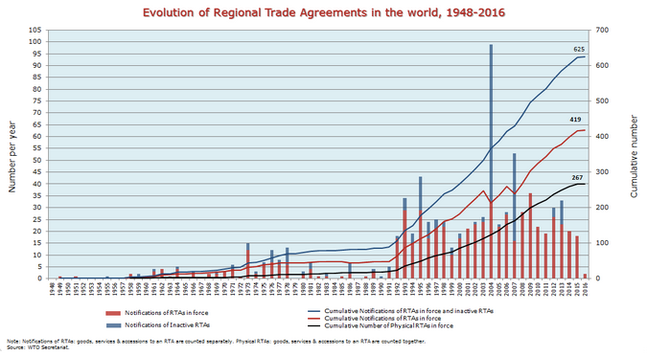
WTO
Notes:
https://www.wto.org/english/tratop_e/region_e/regfac_e.htm

Slide 7
How Trade Negotiations Have Changed
China’s FTAs
2003 Hong Kong | 2008 Singapore
2003 Macao | 2009 Peru
2004 ASEAN | 2010 Costa Rica
2005 Chile | 2013 Iceland
2006 Pakistan | 2013 Switzerland
2008 New Zealand | 2015 S Korea
Years are dates FTAs on goods were signed.

Slide 8
How Trade Negotiations Have Changed
China’s FTAs: In Process
Canada | SADC
East African Com. | Singapore
India | Thailand
Japan | US TTIP
Malaysia | Vietnam
Philippines | West Africa

Slide 19
Today: “Mega-FTAs”
Mega-FTAs of the Past
  European Union (grew from 6 to 28 countries) – Customs Union
  MERCOSUR (Grew from 4 to South American countries)
  ASEAN FTA (10 countries)

Slide 20
Today: “Mega-FTAs”
TPP: Trans-Pacific Partnership
  12 countries
  Negotiations completed Oct 5, 2015
  Yet to be ratified
  Intended to be open to additional countries
    Indonesia
    S. Korea
    Philippines

Slide 21
Today: “Mega-FTAs”
RCEP: Regional Comprehensive Economic Partnership
  10-member ASEAN, plus 6 countries with which ASEAN has FTAs:
    Australia
    China
    India
    Japan
    S. Korea
    New Zealand

Slide 22
Today: “Mega-FTAs”
TTIP: Trans-Atlantic Trade and Investment Partnership
  US
  28-member EU

Slide 23
More on TPP

Slide 24
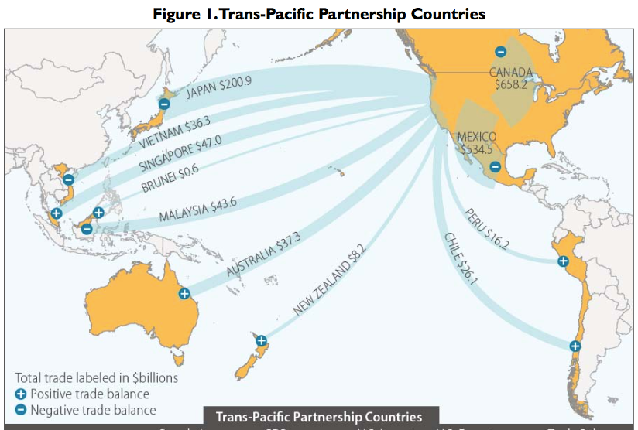
X?

Slide 25
What Is the TPP?
Main Features of TPP (only a few of 30 chapters):
  Trade in goods: Reduce/remove tariffs & NTBs
  Trade in services: Reduce/remove barriers
  Digital trade: Facilitate data flows and E-commerce
  Investment: Investor/State Dispute Resolution
  Intellectual Property: Expanded patents, etc.
  Labor: Enforcement of standards
  Environment: Enforcement of standards
  State-Owned Firms: Competitive neutrality

Slide 26
Oddities of the TPP
Tariffs
  Cars and trucks: US tariffs removed
    Cars: 2.5%, removal phased in over 25 years.
    Trucks: 25%, removal phased in over 30 Years.
  Schedules and rates differ by exporting country

Slide 27
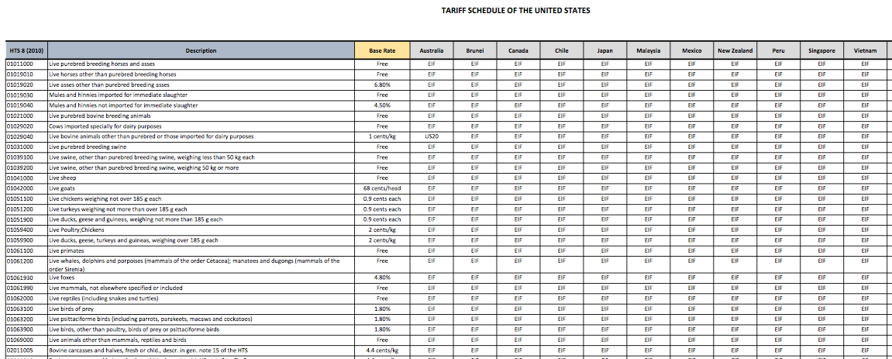

Slide 28
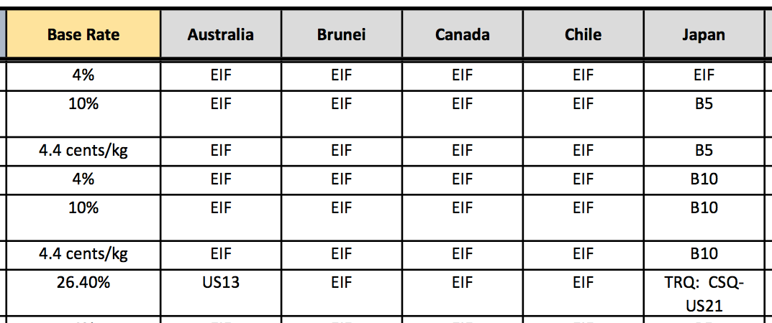
EIF: Entry In Force (duty-free from start)
B10: Eliminated in 10 annual stages, duty-free in year 10
Bovine Meat Cuts (i.e., Beef)
US21: No higher that Peru FTA
US13: Base rate until 2022; duty-free in 2022

Slide 29
Oddities of the TPP
ISDS: Investor/State Dispute Resolution
  Controversial
  Does not apply to tobacco industry

Slide 30
Oddities of the TPP
Biologic Drugs
    (advanced medicines made from living organisms)
  The issue: Time period of permitted data exclusivity
  US wanted 12 years of protection, as contained in the Obama Care.
  Australia and others wanted much shorter protection, 5 or 6 years.
  Compromise: US keeps 12-years; others will not. 5 years protection will be an increase for some countries.

Slide 31
Oddities of the TPP
Japanese Agriculture:
  Japan will lower its tariff on beef from over 38.5% to 9% over 16 years
  Pork tariff will fall from 4.3% to 2.2%, but will also lower minimum import price from ¥482/kg to ¥125, and later to ¥50.
  Rice (no cut in tariff): New duty-free quota of 50,000 tons, rising to 75,000 tons in year 13

Slide 32
Oddities of the TPP
Exchange Rates
  US wanted TPP to address currency undervaluation (which makes exports cheaper)
  Resolution: Side Agreement on Exchange Rates:
    Commitment to avoid manipulation
    Transparency and Reporting
    Group to meet at least annually to discuss macroeconomic and exchange rate issues
    No enforcement mechanism

Slide 33
Pros and Cons of all FTAs
Preferential tariff cuts
  Pro: trade creation
    Similar to the classic “gains from trade”
  Cons:
    Trade diversion
    Rules of origin (ROOs)
    Exemption of sensitive sectors
      Sensitive = Most likely to be trade-creating if included

Slide 34
Pros and Cons of all FTAs
Other aspects of actual FTAs
  Pros:
    Extension to trade in services
    Harmonization of regulations
  Cons (?):
    Extension of IP protection
    Trade enforcement of labor standards
    Trade enforcement of environmental standards
    Investor-State Dispute Settlement

Slide 35
Additional Pros and Cons of Mega-FTAs
Preferential tariff cuts
  Pros:
    Larger potential for trade creation
    If ROOs are cumulative, less distorting
    Potential for adding members
    Replace multiple rules with a single set
  Cons:
    Though there are fewer outsiders, each is harmed more by trade diversion
    In fact (in TPP) there is more complexity

Slide 36
Additional Pros and Cons of Mega-FTAs
Other aspects of actual Mega-FTAs
  Pros:
    May contribute to broader and more uniform standards
  Cons:
    Their use as weapons of geopolitics

Slide 37
Implications of Mega-FTAs for the WTO
Might have created pressure to complete Doha Round.
  Possible, just as NAFTA motivated Uruguay Round
  Didn’t happen; Round is dead.

Slide 38
Implications of Mega-FTAs for the WTO
By lowering trade barriers regionally, Mega-FTAs will
  Hasten the decline of uncompetitive industries,
  Thus gradually reduce political forces for protection
  This may reduce the need to use WTO-sanctioned administrative protection (anti-dumping, etc.)

Slide 39
Implications of Mega-FTAs for the WTO
Trade disputes will have alternative fora in which to be settled: Choice between WTO panels and FTA panels
  This may lessen the role of the WTO Dispute Settlement Mechanism
  But it will remain relevant

Slide 40
Implications of Mega-FTAs for the WTO
WTO will continue to be important for plurilateral negotiations on issues that transcend the Mega-FTAs
Some issues that lend themselves neither to plurilateral agreements not to Mega-FTAs will remain unresolved
  Most important: Subsidies

Slide 41
Implications of Mega-FTAs for China
China must decide which Mega-FTAs
  To join (TPP)
  To create (RCEP)
  To push for (FTAAP = Free Trade Area of Asia and the Pacific)
Will China seek to use FTAs to
  Wall itself off from other major countries?
  Or join in economic integration with other major countries?

Slide 42
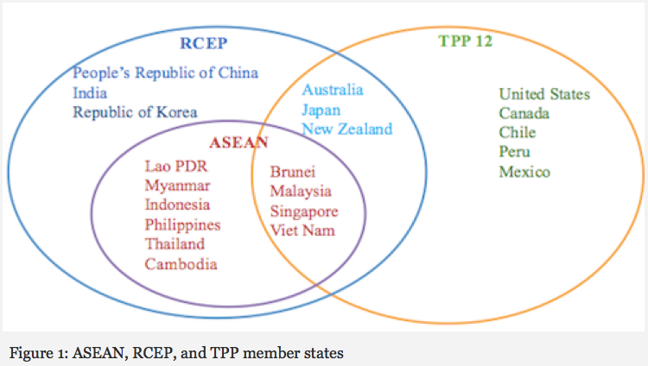
Notes:
http://asiafoundation.org/in-asia/2015/09/09/tpp-and-rcep-boon-or-bane-for-asean/

Slide 43
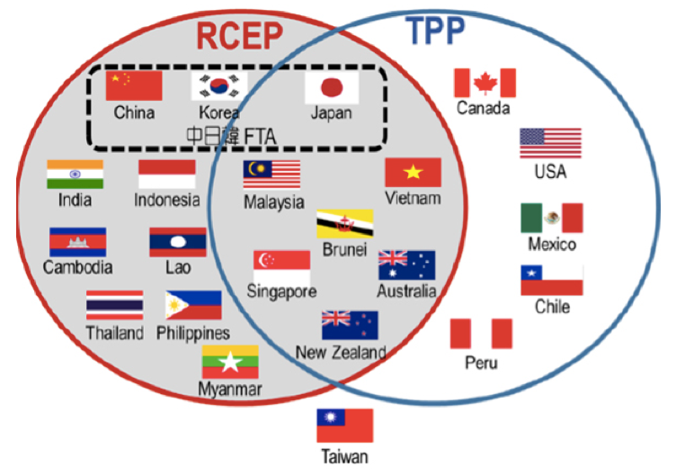
Notes:
http://www.postwesternworld.com/2015/08/21/tussle-regional-influence/

Slide 44
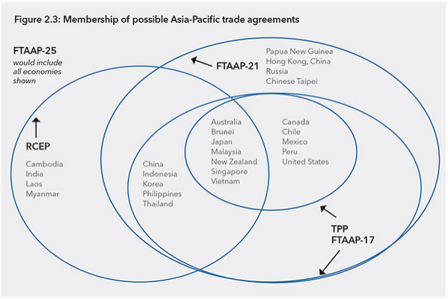
Notes:
http://www.pecc.org/state-of-the-region-report-2014/265-state-of-the-region/2014-2015/595-chapter-2-can-rcep-and-the-tpp-be-path-ways-to-ftaap

Slide 45
Implications of Mega-FTAs for China: TPP
If China does not join TPP
  Will suffer from trade diversion in countries without China FTAs
    US, Japan
    Others
  Will suffer from trade diversion due to ROOs even in countries with China FTAs
    Chile, Peru, members of ASEAN

Slide 46
Implications of Mega-FTAs for China: TPP
If China does not join TPP
  Will not be subject to non-trade requirements of TPP
    State owned enterprises
    Labor Standards
    Environment
  May not need to open trade as much as TPP requires

Slide 47
Implications of Mega-FTAs for China: RCEP
If RCEP, including China, succeeds
  Minimal trade creation/diversion, since China already has FTAs with ASEAN and some other RCEP members
    S Korea
    New Zealand
  Largest effect will be FTA with Japan
    Some trade creation
    Reversal of prior trade diversion from Japan’s other FTAs, including TPP.

Slide 48
Implications of Mega-FTAs for China: RCEP
If RCEP, including China, succeeds
  If it cumulates rules of origin, RCEP will reduce trade and investment diversion due to ROOs.
Though initiated by ASEAN, RCEP will be viewed as a political triumph of China in building a China-centered economic bloc.

